Slide 1
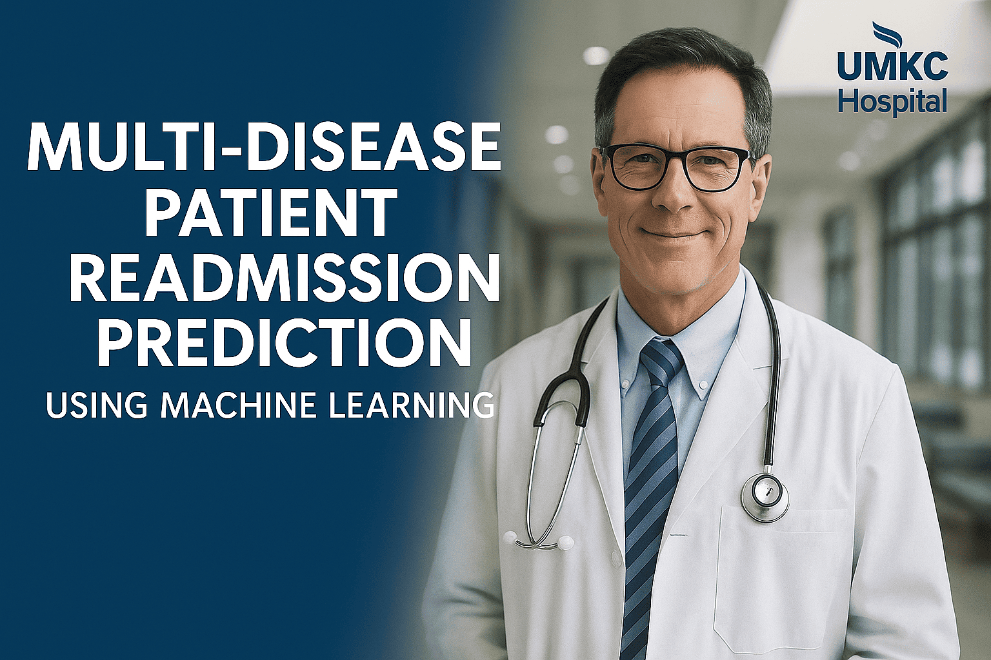

Slide 2

The Squad
TEAM I
Presented By Sahithi Thota Reethu gopavarapu
Sathwik Reddy
Srija Reddy

Slide 3
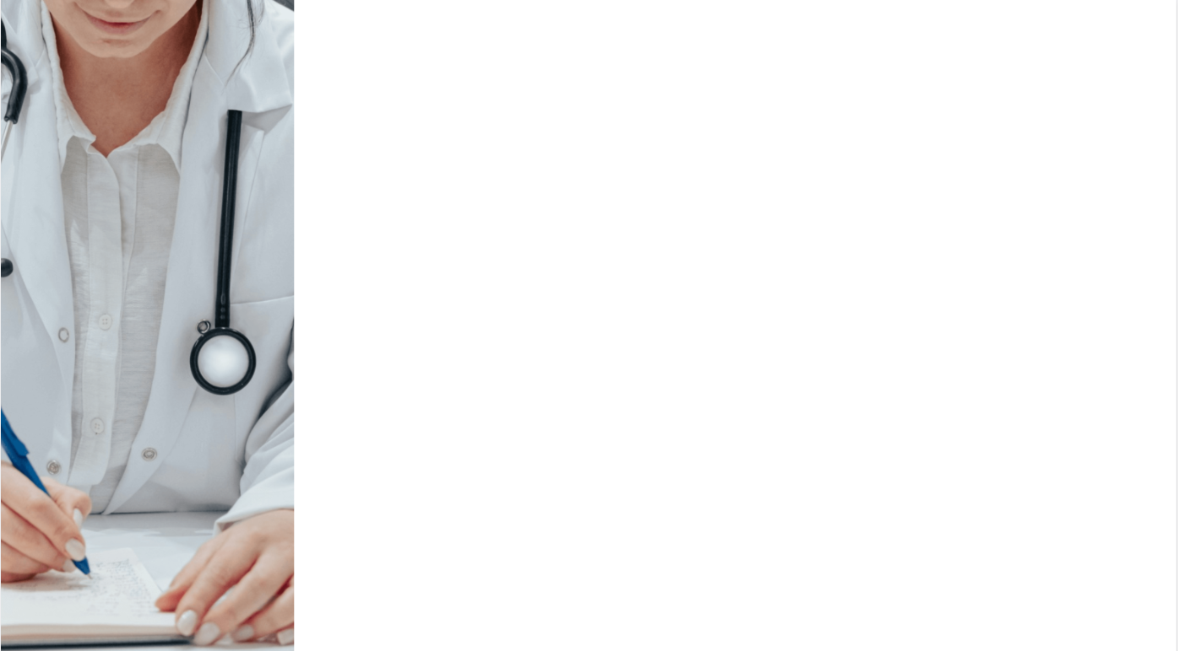
Agenda
Introduction
Problem Statement
Objectives
Methodology
System Architecture
Model and Prediction
Frontend & Backend Functionality
Results
Conclusion
Future Work

Slide 4

INTRODUCTION
Hospital readmissions are a major burden on healthcare systems. This project focuses on predicting 30-day readmission risks for diabetic and heart failure patients using machine learning. The system integrates an XGBoost model, random Forest, Logistic Regression a Flask backend, and HTML/CSS frontend and javscript with dual login portals for doctors and patients. It displays patient-specific risk scores, supports communication, and helps hospitals forecast bed and staff needs. All patient and prediction data is stored securely in the cloud for scalability.

Slide 5
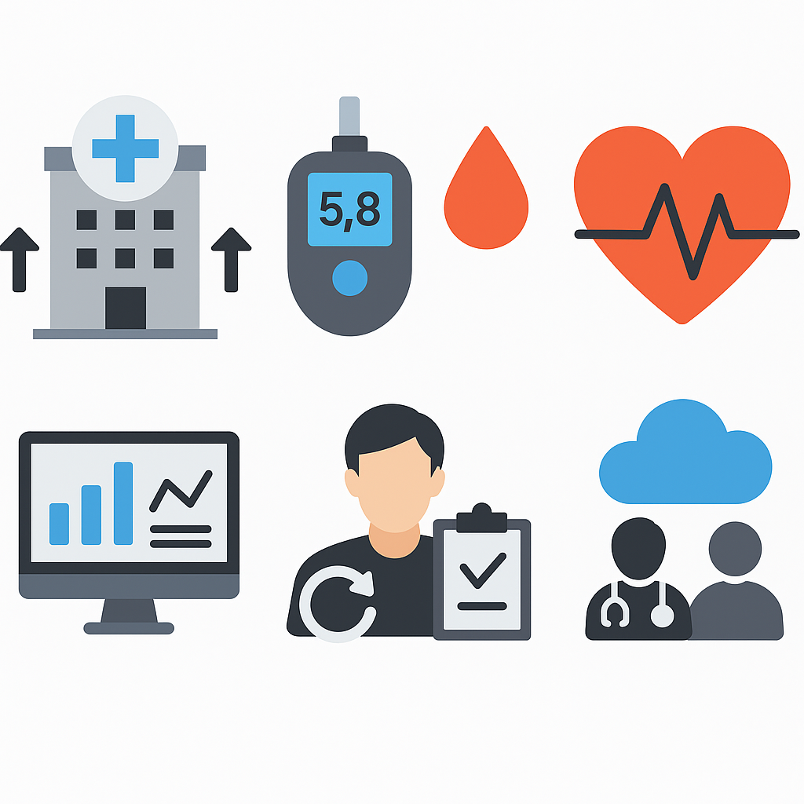
PROBLEM STATEMENT
Hospital readmissions increase treatment cost and workload.
Chronic diseases like diabetes and heart failure have high recurrence.
Traditional follow-up systems lack predictive insights.
Hospitals struggle with real-time resource planning.
Patients often don’t get timely follow-up or risk feedback.
A data-driven, interactive platform is needed for prediction, planning, and communication.

Slide 6

OBJECTIVES
Predict 30-day hospital readmission risk.
Identify significant factors affecting readmission.
Generate interpretable risk scores (Low/Medium/High).
Simulate staffing and bed requirements.
Enable doctor-patient communication and report sharing.
Store and process all data securely on the cloud

Slide 7
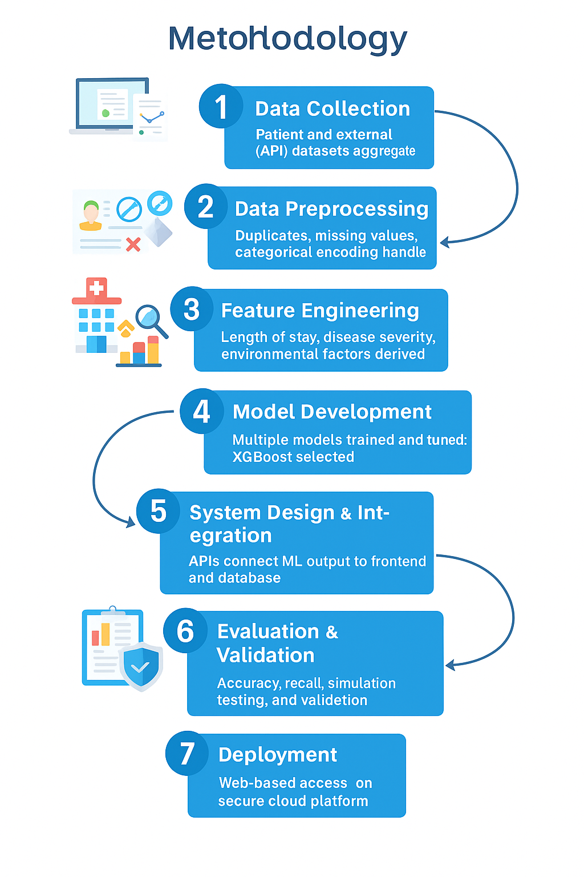
METHODOLOGY
End-to-End Pipeline: Starts from data ingestion (EHR + external APIs) → ends with web-based prediction system.
ML Model (Random Forest): Chosen for its high AUC and interpretability (with SHAP).
Dual-Login Architecture: One system for doctors (dashboard, simulation) and one for patients (risk report, communication).
Cloud-Ready Design: Deployed on Google Cloud or AWS with PostgreSQL for persistent, secure storage.
Interoperability: APIs connect the ML model with the frontend; usable from multiple UIs (React/Streamlit).

Slide 8
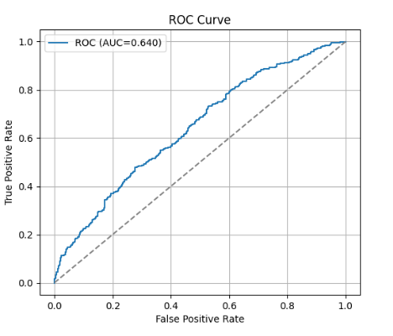
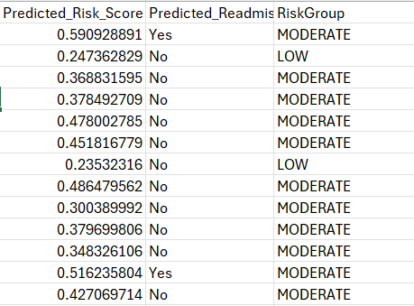
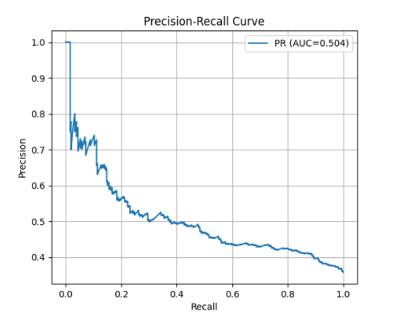
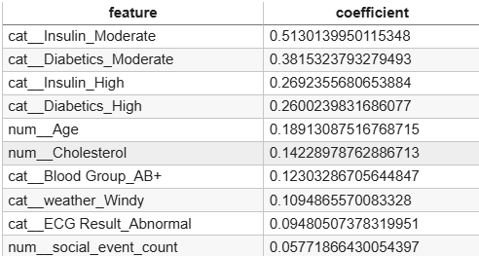
ML Model & Risk Scoring
Model: Random Classifier
Input: Age, diagnosis, lab values, previous admissions
Output: Readmission risk (probability 0–1)
Risk Categories:
0.0–0.3: Low
0.3–0.7: Medium
0.7–1.0: High
Performance:
Diabetics
Accuracy: 0.64
AUC: 0.66
Heart failure
Accuracy: 0.64
AUC: 0.66

Slide 9
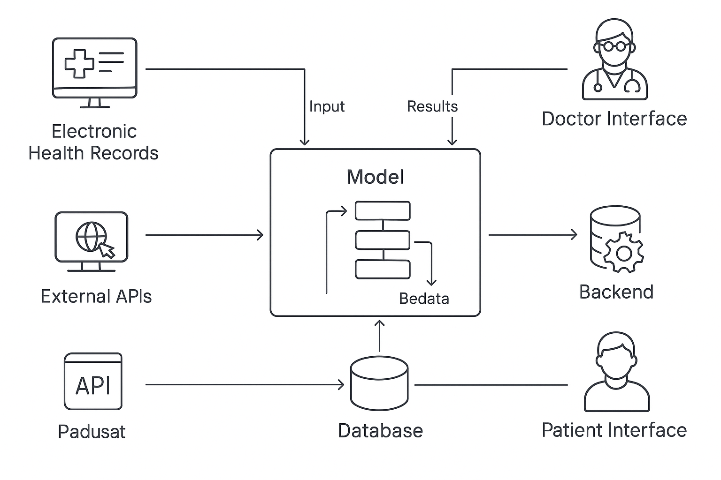
DATA FLOW DIAGRAM

Slide 10
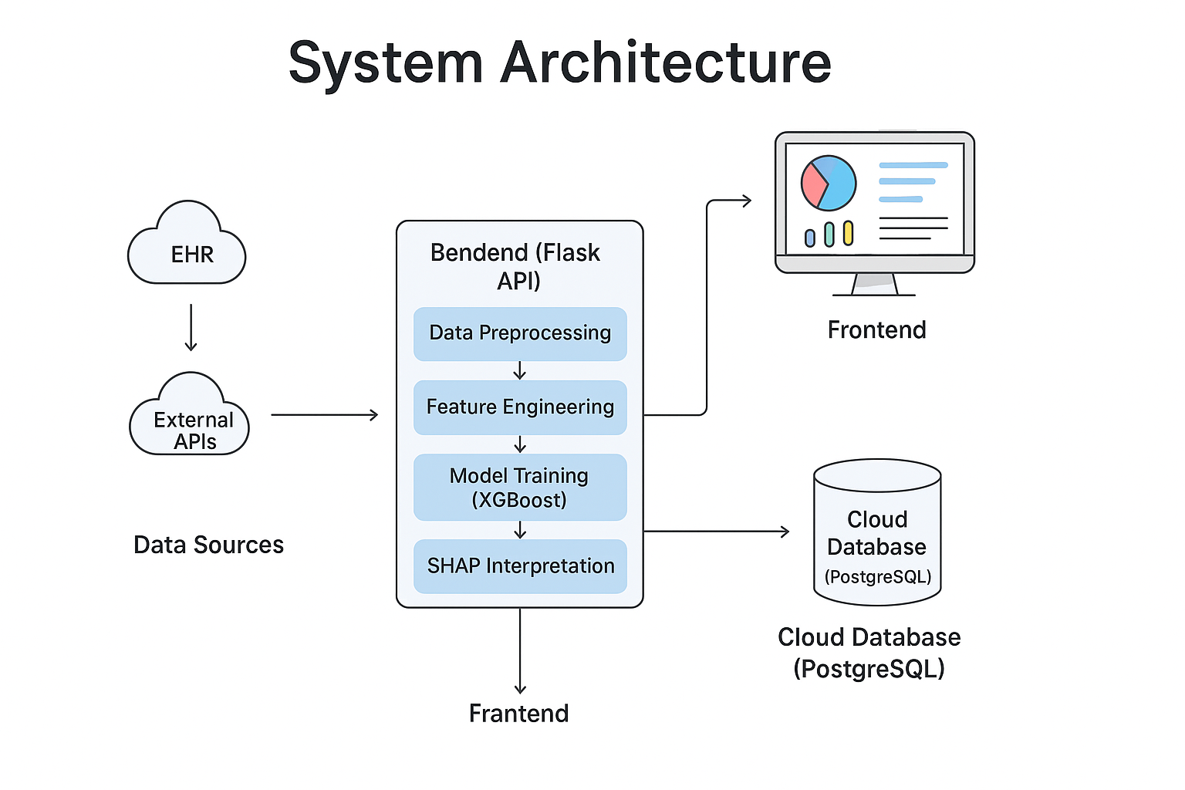
SYSTEM ARCHITECTURE
MODULES
Frontend: HTML,CSS, JavaScript, plotly dashboards for visualization
Backend: Flask for API + business logic
ML Model: Trained scikit-learn/Random Forest models
Database: PostgreSQL for storing patient and prediction data
Cloud Integration: AWS for scalability
Doctor Login: View patient readmission predictions, bed/staff forecasts
Patient Login: View personal reports, receive notifications & doctor feedback

Slide 11

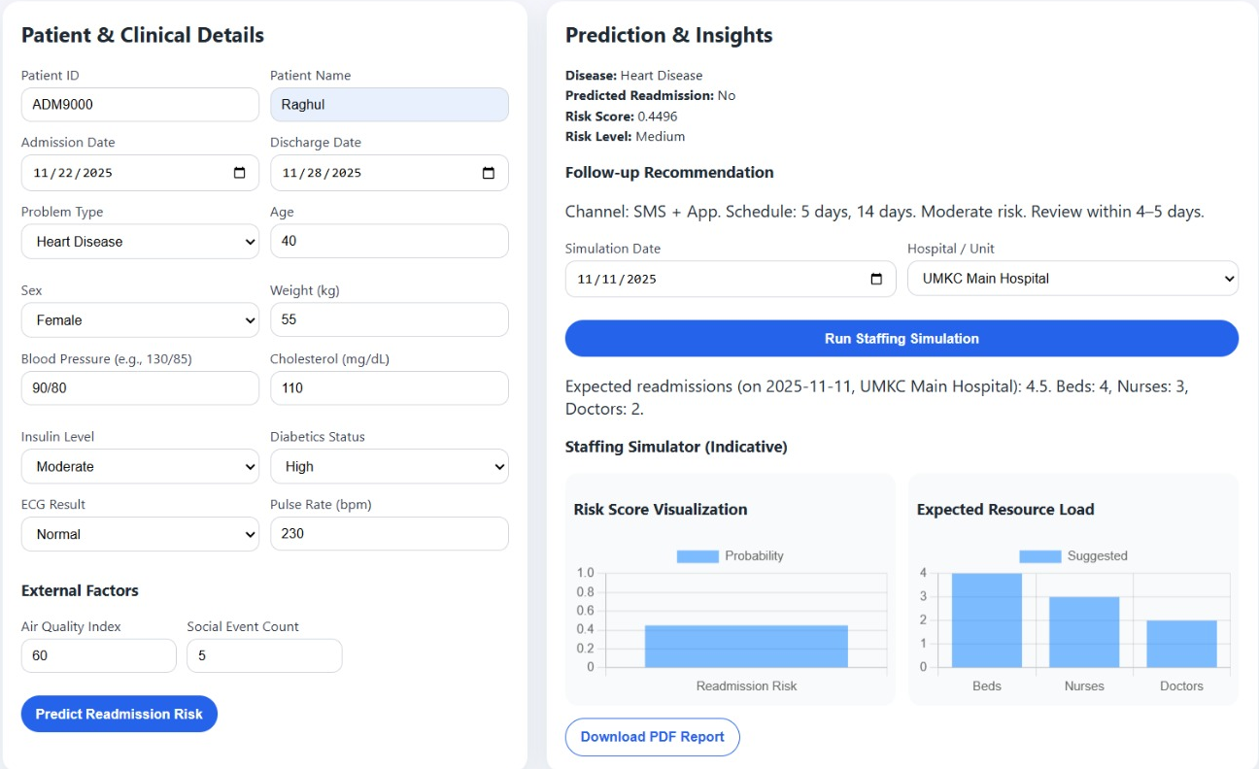
RESULTS

Slide 12
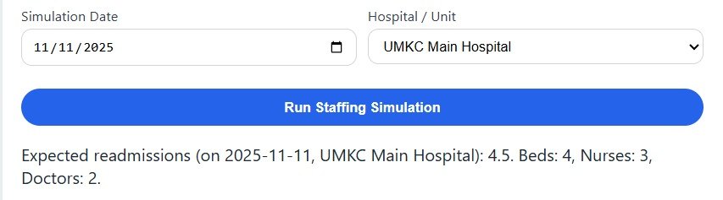
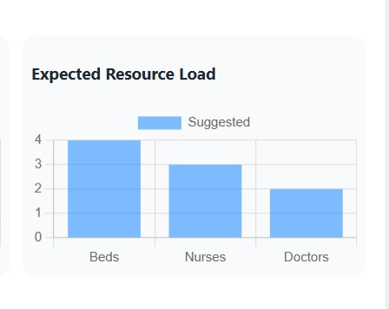
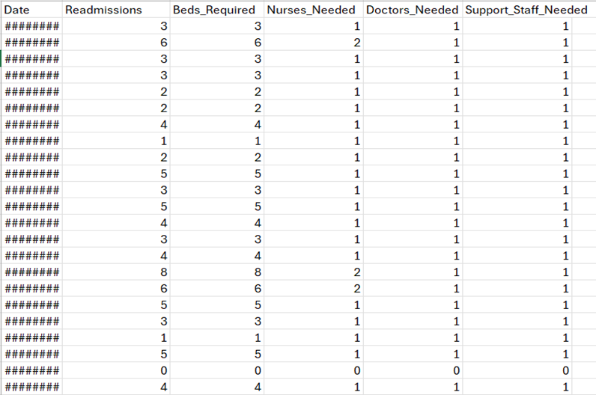
STAFF SIMULATION &VISUALIZATION

Slide 13
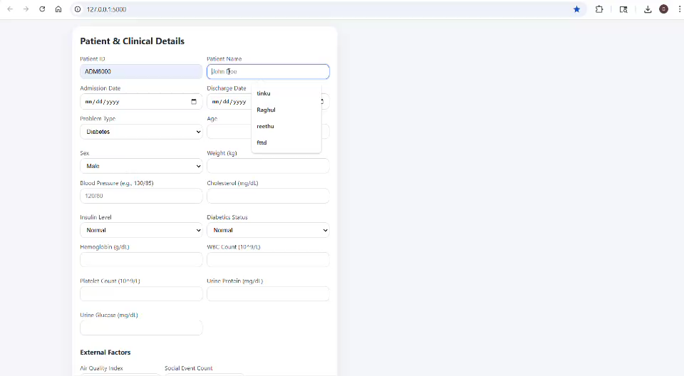
VIDEO PRESENTATION

Slide 14
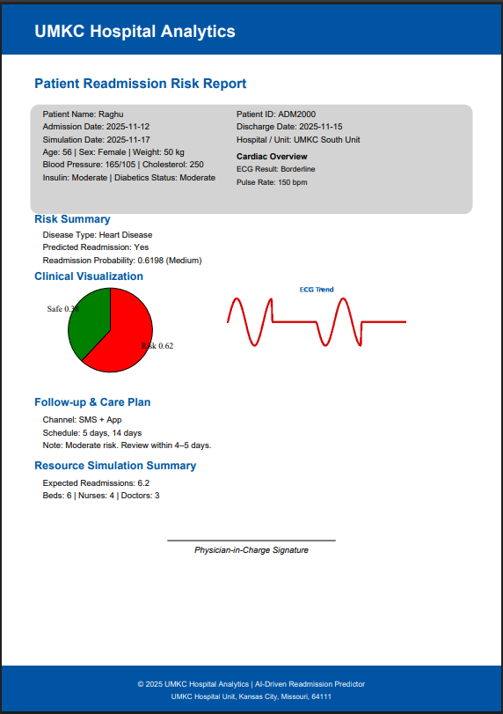
RESULT PDF REPORT
HEART FAILURE

Slide 15
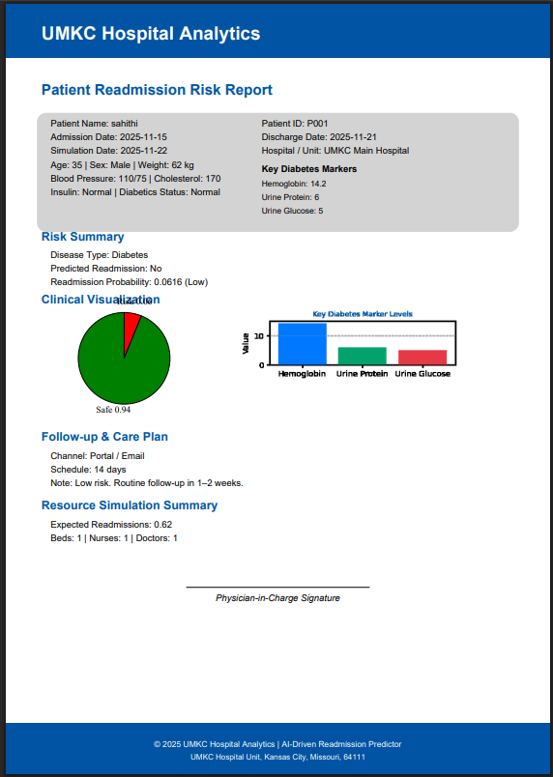
RESULT PDF REPORT
DIABETICS

Slide 16

CONCLUSION
This project successfully developed a machine learning–based healthcare readmission prediction system that integrates clinical data, environmental factors, and cloud technology to improve patient care and hospital efficiency. By accurately predicting readmission risks for diabetes and heart failure patients, the system enables doctors to take preventive actions and optimize staff and bed utilization. The inclusion of interactive dashboards and a dual login interface enhances communication between doctors and patients, ensuring timely follow-ups and better outcomes. Overall, the project demonstrates how data-driven insights and automation can significantly reduce preventable readmissions and support smarter healthcare management.

Slide 17


